Slide 1
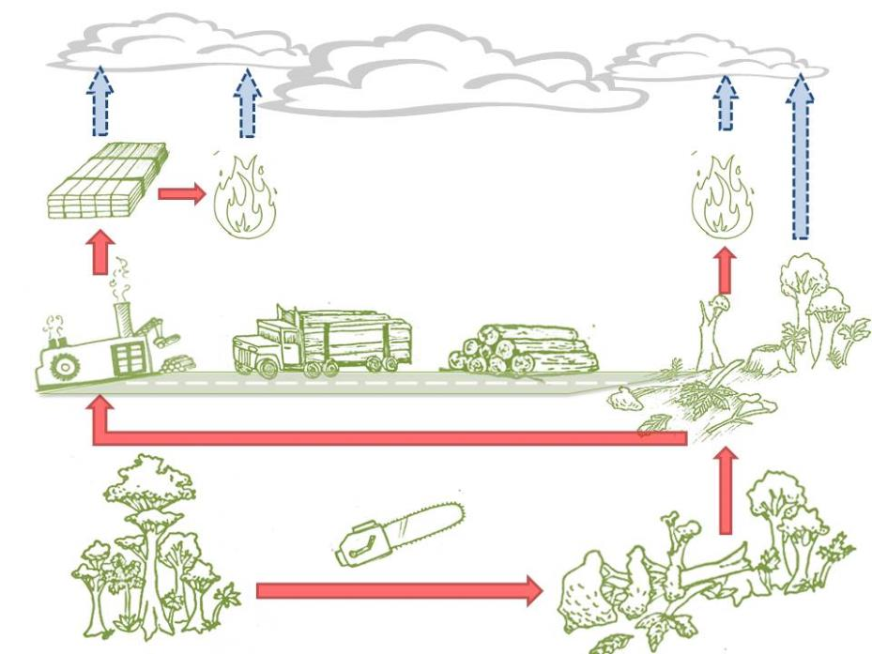
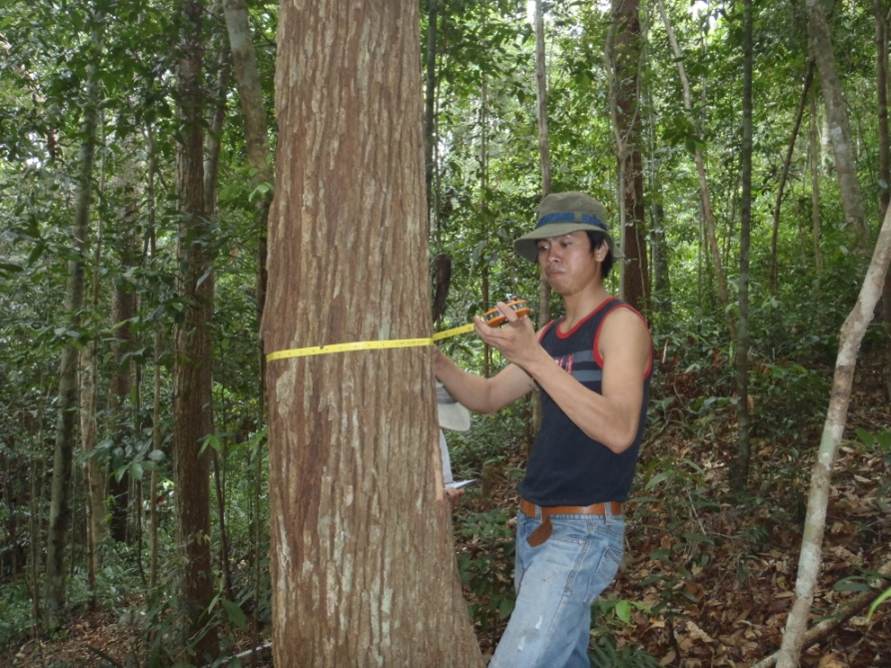



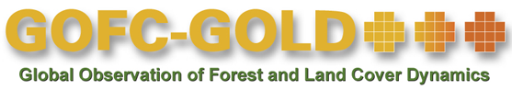
Module 2.3 Estimating emission factors for forest cover change: Deforestation
Module developers:
  Sandra Brown, Winrock International
  Lara Murray, Winrock International
Country example:
  Guyana
  All data courtesy of Winrock International and Guyana Forestry Commission
V1, May 2015
Creative Commons License

Slide 2
Outline of country example
REDD+ development in Guyana
Approach to sampling and stratification in Guyana
Stratification by threat of deforestation
Collecting primary data field data for planning
QA/QC measures
Carbon stock data and emission factors

Slide 3
REDD+ development in Guyana
Guyana is an example of a high forest cover, low deforestation rate (HFLD) country.
Since 2009, the Government of Norway has provided performance-based finance to implement a low-carbon development strategy (LCDS).
Guyana is a World Bank FCPF pilot country.

Slide 4
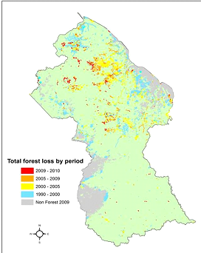
Drivers of deforestation and degradation in Guyana
Forest cover change 1990-2010
The national scope
Deforestation:
  Mining—medium and large scale
  Infrastructure—roads, settlements
  Agriculture—permanent
  Fire from human actions
Degradation:
  Forestry—for timber production
  Mining—small scale
  Shifting cultivation
  Fire from human actions
Total forest loss by period
2009-2010
2005-2009
2000-2005
1990-2000
Non Forest 2009

Slide 5
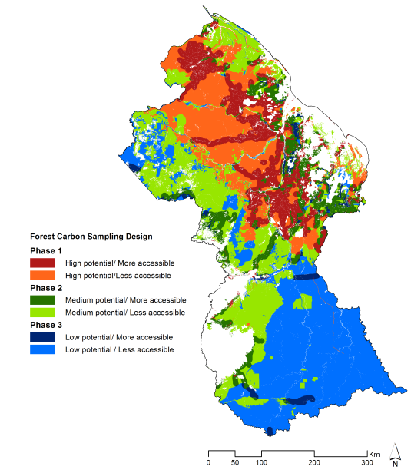
Stratification by threat using spatially explicit land-use change modeling
Use spatially explicit land-use change model
Identify key factors impacting historical deforestation patterns
Identify areas with high suitability for deforestation
Create deforestation threat map
Notes:
This example includes a spatially explicit land-use change modeling process to come up with a stratification map. However, it is not always necessary to do such an extensive analysis. Countries can do a less sophisticated stratification by threat analysis and still come out with decent strata that will likely work out in terms of sampling efficiencies.
See Module 2.3 lecture slides for more details, especially slides 25-28, which descibe why stratifying by threat can be useful for stratifying for deforestation. For Guyana, where much of the forest land is very inaccessible and still intact, stratifying by threat made sense with limited resources available for collecting field data. Also the high threat area is where most of the deforestation has taken place.

Slide 6
Stratifying forest lands in Guyana
Factors in 2000:
  Roads (main and secondary)
  Rivers
  Settlements
  Townships (markets)
  Eligible areas (mining and forestry concessions, protected areas, state forest, state land, Amerindian areas)
  Forest species composition
  Fire incidents per forest species type
  Elevation
  Slope
  Soil dominant class
Roads
Heuristic factors
Elevation
Eligible land
2000
Roads
Eligible land
2000
Townships/
markets
Roads
Empirical factors
Elevation
Roads
Elevation
Eligible land
2000
Townships/
markets
Notes:
These maps give the factors that were used to stratify Guyana by threat for deforestation. All of this work was done in a GIS using Idrisi’s land change modeler (LCM).

Slide 7
Stratification by threat of deforestation
GEOMOD analysis was used to identify spatial patterns of change in relation to drivers and other factors and generate a “threat map.”
Stratifying by “threat” allows for estimating carbon stocks of forests where changes have occurred and likely to occur in future.
This reduces sampling effort while maintaining low uncertainty in estimates of emission factors.

Slide 8
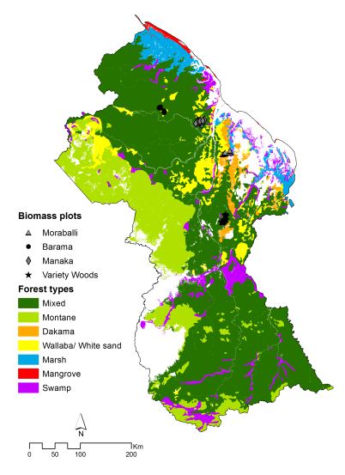
Collection of primary field data for planning
24 Single Plots—mean +/- 95% CI
29 Cluster Plots—mean +/-95% CI
Mean t C/ha±95%CI
No difference in C stocks of main forest types
No further stratification by forest type
Forest type
Notes:
The overall mean was the same for single plots as for cluster plots, but notice that the 95% confidence interval (CI) is very much smaller for cluster plots than for single plots. Also note that the mean by forest type (about 250 t C/ha or less) is lower than the mean total shown in the tables. This is because the graph is plotting only the sum of aboveground and belowground tree biomass carbon.

Slide 9
Decisions on sampling design for developing emission factors
Use stratified two-stage list sampling design with clustered plots
Divide sampling into three phases: phase 1 = high threat area, phase 2 = medium threat area, phase 3 = low threat area
No need to stratify by forest type in high threat zone
Need to stratify by accessibility for cost-effective sampling—divided into more accessible (area of buffer of 5 km width on each side of all roads) and less accessible (area outside buffer)
Preliminary data used to estimate number of cluster plots to be installed in the more accessible and less accessible strata
Include the following C pools: aboveground biomass of trees to 5 cm minimum DBH, standing and lying dead wood, litter, and soil to 30 cm depth
Notes:
DBH = diameter breast height

Slide 10
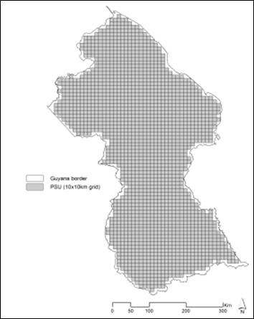
Sampling design for obtaining estimates of C stocks for developing EFs
The country is divided systematically into 10 km x 10 km blocks (primary sampling units, PSUs) (left).
The forest is divided into accessibility strata and phases (middle).
PSUs within each stratum are selected using a stratified two-stage list sampling design for carbon measurement (right).
Secondary sampling units (SSUs) designed as L-shaped clusters are established within each PSU, and carbon measurements are obtained.

Slide 11
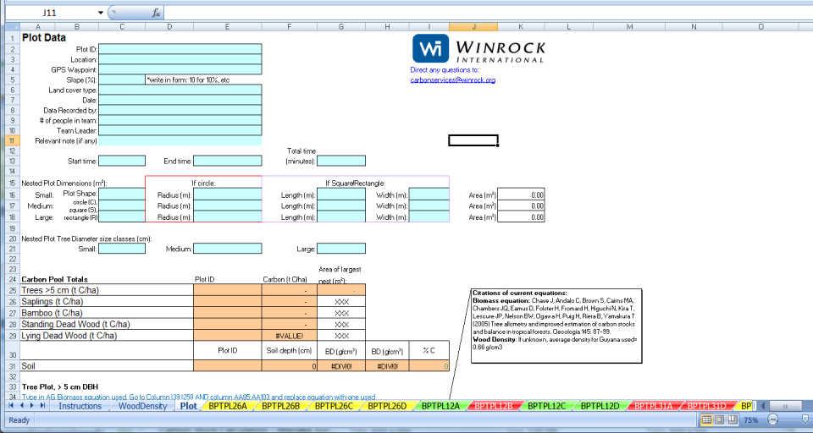
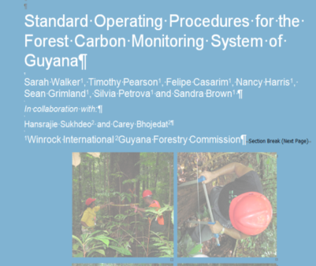
QA/QC: SOPs and tools to automate calculations for all field data
Worksheet links to data collected using standard operating principles (SOPs)
11

Slide 12
Development of emission factors (EFs) for deforestation
EF developed = from field measurements of 40 cluster plots (overall precision 95%, CI = 12% of mean)
Carbon stocks in all pools
C stock change in soil
These values were used to develop EFs for deforestation.
Post deforestation stocks for biomass pools = 0.

Slide 13
Development of emission factors for deforestation
EFs including all pools and changes in soil stocks by stratum and driver for high threat area

Slide 14
Recommended modules as follow-up
Module 2.4 to learn about involving communities / local experts in monitoring changes in forest area and carbon stocks.
Module 2.5 to estimate carbon emissions from deforestation and forest degradation
Modules 3.1 to 3.3 to proceed REDD+ assessment and reporting.

