Slide 1
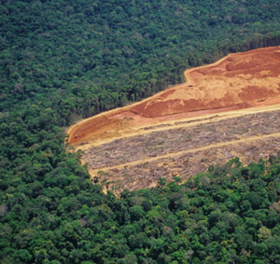
Module 1.3 Assessing and analyzing drivers of deforestation and forest degradation
Module developers:
Erika Romijn, Wageningen University
Martin Herold, Wageningen University
Country examples:
National analysis of drivers of deforestation in
Democratic Republic of the Congo
Indonesia
Photo credit: AFP
V1, May 2015
Creative Commons License

Slide 2
1. Democratic Republic of the Congo (DRC): National analysis of drivers of deforestation
DRC is actively participating in REDD+ and performed a national analysis of drivers of deforestation and forest degradation that included:
Qualitative assessments
By civil society
By UN Environment Programme (UNEP)
Quantitative assessment
By Université catholique de Louvain (UCL)
Synthesis of all studies
Notes:
The DRC is strongly committed to and actively participating in REDD+. DRC’s REDD Preparation Plan (R-PP), submitted in 2010, affirmed the need to gather more information on the drivers of deforestation in the country.
In 2010 and 2011 different analyses of direct and underlying drivers of deforestation were performed by civil society from the DRC, the Food and Agriculture Organization (FAO), UCL, and UNEP. A report from the ministry of environment, conservation of nature and tourism, which was produced in the frame of the UN-REDD programme, summarizes these different studies and is used to inform the national REDD+ process in the country. The studies were complementary and included two qualitative analyses and a quantitative analysis of the drivers of deforestation and forest degradation in the DRC.
Sources:
Defourny, Delhage, and Kibambe Lubamba 2011;
Mahonghol 2012;
MECNT 2012a;
MECNT 2012b.

Slide 3
Qualitative analysis by civil society
Extensive literature review
Interviews with four to seven experts per province, to list the 10 most important direct and indirect drivers per province
Direct drivers consolidated at national level:
Slash-and-burn agriculture practiced by farmers
Local wood consumption
Charcoal and fuel wood / firewood
Indirect drivers consolidated at national level:
Population growth
Poverty of local population (farmers)
Administrative deficit
Notes:
Qualitative analysis by civil society
The first qualitative analysis consisted of extensive literature review and interviews with experts. Four to seven experts from universities, local communities, the forestry sector, civil society, and NGOs with a focus on nature conservation were selected per province to give their individual opinions during workshops and interviews. In focus groups the experts discussed the drivers of deforestation and reached consensus on the most important drivers for each province. This resulted in a list with the 10 most important direct drivers and the 10 most important indirect drivers per province. The results for the separate provinces were then consolidated at the national level. Drivers were compared on a province-by-province basis. Common viewpoints were grouped into a family tree called “Stemma.” The different viewpoints received a score based on group trends. This resulted in a classification of the direct and indirect drivers of deforestation and forest degradation per province in order of importance.
The analysis resulted in the following ranking of direct drivers of deforestation and forest degradation at the national level:
1. Slash-and-burn agriculture practiced by farmers
2. Local wood consumption
3. Charcoal and fuel wood / firewood
Indirect drivers of deforestation and forest degradation at the national level were ranked as follows:
1. Population growth
2. Poverty of local population (farmers)
3. Administrative deficit
Source:
MECNT 2012a.

Slide 4
Qualitative analysis by UNEP
Selection of 40 deforestation sites: literature review, field observations, and interviews with experts and different actors
Direct drivers consolidated at national level:
Slash-and-burn agriculture
Charcoal production
Causes related to demographics and phenomena such as wildfire
Indirect drivers consolidated at national level:
Population fluctuation
Institutional aspects (successive wars)
Economic aspects (poverty, youth employment)
Notes:
Qualitative analysis by UNEP
Another qualitative study was carried out as part of the Post-Conflict Environmental Assessment (PCEA) of the Democratic Republic of Congo (DRC). The study had three main objectives:
Determine the direct and indirect causes of deforestation and forest degradation in 40 sites across the different provinces of the DRC
Analyze the trends of deforestation and forest degradation in the specific sites
Integrate the results of the drivers analysis in the national REDD+ process, to support the development of the national strategy to develop response measures to reduce the effects of deforestation and or forest degradation
A first analysis of existing maps with information on administrative units, forest cover, climate, forest concessions, changes in forest cover per decennium (based on satellite images analysis), land cover, and other regional maps pointed out the sites where deforestation and forest degradation was taking place. This resulted in a total of 40 sites, with an average of 3 sites per province. Through interviews and questionnaires, literature review and field observations, the following information was gathered for each site: GPS coordinates, a description of the landscape and the land-use activities of the site, photos from different angles showing the landscape, height of the site, history of deforestation, and causes of deforestation. For each site, interviews were held with different actors such as villages heads, farmers, members of civil society (local NGOs), provincial delegations, officials of international organizations, and representatives of the informal sector and the private sector, thereby considering different age groups, gender, cultural background, and vulnerability. A total of 100 people were interviewed across the country. They all listed the three most important direct drivers and the three most important indirect drivers of deforestation. The information was compiled into reports of two to five pages per site, with codes for the various direct drivers of deforestation. Graphs and maps were created with use of statistical analysis in Excel and ArcGIS software to present to collected information for each site.
The analysis resulted in the following ranking of direct drivers of deforestation and forest degradation at the national level:
1. Slash-and-burn agriculture
2. Charcoal production
3. Causes related to demographics and phenomena such as wildfire
The following is the ranking of indirect drivers of deforestation and forest degradation at the national level:
1. Population fluctuation
2. Institutional aspects (successive wars)
3. Economic aspects (poverty, youth employment)
Apart from reaching consensus on the most prominent drivers of deforestation and forest degradation, the study also provided insights for developing a multifunctional vision on national forest zoning and planning and for developing and executing measures to affect deforestation and forest degradation. Building institutions and strengthen national leadership were mentioned as important aspects.
Source:
Mahonghol 2012.

Slide 5
Quantitative study on the relation between direct activities and explanatory variables
Object-based segmentation combined with nonsupervised classification of Landsat satellite images produced land cover maps for 1990, 2000, and 2005
Analysis of land cover changes for 1990–2000 and 2000–2005
Thirty-five explanatory variables were grouped into eight categories of underlying causes: infrastructure, agriculture, forest exploitation, economic factors, transport axes, demographic factors, sociopolitical factors, and biophysical factors
Notes:
Quantitative analysis by Université catholique de Louvain
In a quantitative study the direct drivers of deforestation and forest degradation were analysed at national scale with use of statistical methods, thereby taking into account the spatial dimensions. Through modelling, the relation between the direct activities causing deforestation and forest degradation and various explanatory variables was analysed.
Estimation of deforestation and forest degradation
Deforestation, forest degradation, and reforestation and regeneration were calculated for 1,000 samples of 20 x 20 km of Landsat images (30 m resolution), for two time intervals from 1990 to 2000 and 2000- to 005. For each sample, the land cover was determined with use of object-based multitemporal segmentation, combined with nonsupervised classification. This automatic method resulted in six different land-cover classes. Each sample was subdivided into four subsample, in order to reflect the spatial variability. For these subsamples, deforestation and forest degradation was obtained and subsequently summed per sample. The land cover and land-cover changes were validated by 15 national experts.
Analysis of drivers of deforestation
Based on extensive literature research, 35 explanatory variables, which could potentially be direct or indirect drivers of deforestation and forest degradation, were identified. For all of these variables, spatially explicit information was available. They were grouped into eight different categories of drivers of deforestation and forest degradation: (1) infrastructure, (2) agriculture, (3) forest exploitation (direct drivers), (4) economic factors, (5) transport axes, (6) demographic factors, (7) sociopolitical factors, and (8) biophysical factors (indirect drivers). All data were compiled in ArcGIS, and the values for the different variables were calculated for a quarter of each sample site (10 x 10 km).
Sources:
MECNT 2012b; Defourny, Delhage, and Kibambe Lubamba 2011.

Slide 6
Quantitative study on the relation between direct activities and explanatory variables
Linking land-cover changes (deforestation and degradation) to explanatory factors:
Univariate statistical analysis to quantify the influence of the different explanatory variables during the two different time periods: 1990–2000 and 2000–2005
Multivariate statistical analysis to create explanatory models for combinations of underlying causes of deforestation
Notes:
Two different regression models (univariate and multivariate) were used to identify the main drivers of deforestation and forest degradation in each sample site for the two different time periods: 1990–2000 and 2000–2005. Samples were analysed only when they contained a forest area of more than 25%.
Univariate statistical analysis
Univariate statistical analysis was used to calculate the correlation between each of the explanatory variables and the areas of deforestation and forest degradation. With use of the Pearson correlation coefficient the existence of linear relationships was examined. This was done both for net and gross deforestation and forest degradation.
The variables which were most correlated with gross deforestation and forest degradation were the following: (1) area of agricultural (rural) complex, (2) population growth, (3) degraded forest, (4) roads, (5) forest fragmentation, (6) distance to agricultural zones, and (7) density of villages. However, the contribution of each variable differed per region.
Multivariate statistical analysis
Four different approaches were used to select the variables that were included in the multivariate regression models. These included exhaustive, forward, backward, and step-wise analyses. Different combinations of variables were tested in multivariate regression models By removing correlated and nonsignificant variables the models were refined. Multivariate statistical analysis was used to create explanatory models for combinations of direct and indirect drivers of deforestation. Modelling was done on a national scale and on a subnational scale for 11 regions based on WWF (World Wildlife Fund) ecoregions and different land uses, in order to take the diversity and local characteristics into account.

Slide 7
Direct drivers, explanatory factors, and underlying causes of deforestation
 | Direct drivers | Explanatory variables | Indirect drivers
1 | Slash-and-burn agriculture | Biophysical factors: degraded forests | Population growth
2 | Local wood consumption | Biophysical factors: fragmentation | Institutional aspects (political decisions, mismanagement, civil wars)
3 | Charcoal and fuel wood / firewood | Agriculture: rural complex | Infrastructure and urbanization
4 | Mining | Transport roads | Economic aspects: economic crisis, unemployment, poverty
5 | Bushfire | Demographic factors: population growth
Notes:
The slide shows the most important direct drivers, explanatory factors, and indirect drivers of deforestation listed in order of importance (not in relation to each other).
Direct drivers varied per province. However, consolidated at national level, both qualitative studies showed that the most important direct driver of deforestation was slash-and-burn agriculture. Other prominent activities were local wood consumption, fuel wood collection, charcoal production, and mining. The studies found that most deforestation activities were practiced by rural people for their subsistence and financial needs. These are mainly small-scale activities but are sometimes practiced at large scale and/or at high intensity.
The most important indirect driver, found by both qualitative studies, was population growth. A weak institutional framework due to the political situation (civil wars and bad governance) and difficult economic environment (economic crisis, unemployment, and poverty) accelerated deforestation activities. Other indirect drivers were infrastructure creation and urbanization.
Deforestation was strongly correlated to biophysical explanatory factors such as the presence of degraded forests and occurrence of forest fragmentation. Hence, the drivers of deforestation were the same as the drivers of forest degradation. Other factors, such as agriculture (distance to rural complexes), transportation, roads, and population growth also showed a high correlation with deforestation and forest degradation.
Due to the heterogeneity in drivers per province, it is important that the REDD+ strategy and action plans are focused at the subnational level to tackle the single drivers of deforestation that are active in each province.

Slide 8
2. Indonesia: Drivers of deforestation analysis using national data
How to derive quantitative driver information based on land cover maps?
Notes:
In a recent study, three different forest definitions were used to analyse the direct drivers of deforestation for Indonesia. Drivers analysis was performed based on a time-series analysis of four different land-cover maps, using postforest land use as an indicator for direct drivers of deforestation (Romijn et al. 2013).
This country example explains the different steps that were needed to derive quantitative driver information based on land-cover maps for Indonesia.

Slide 9
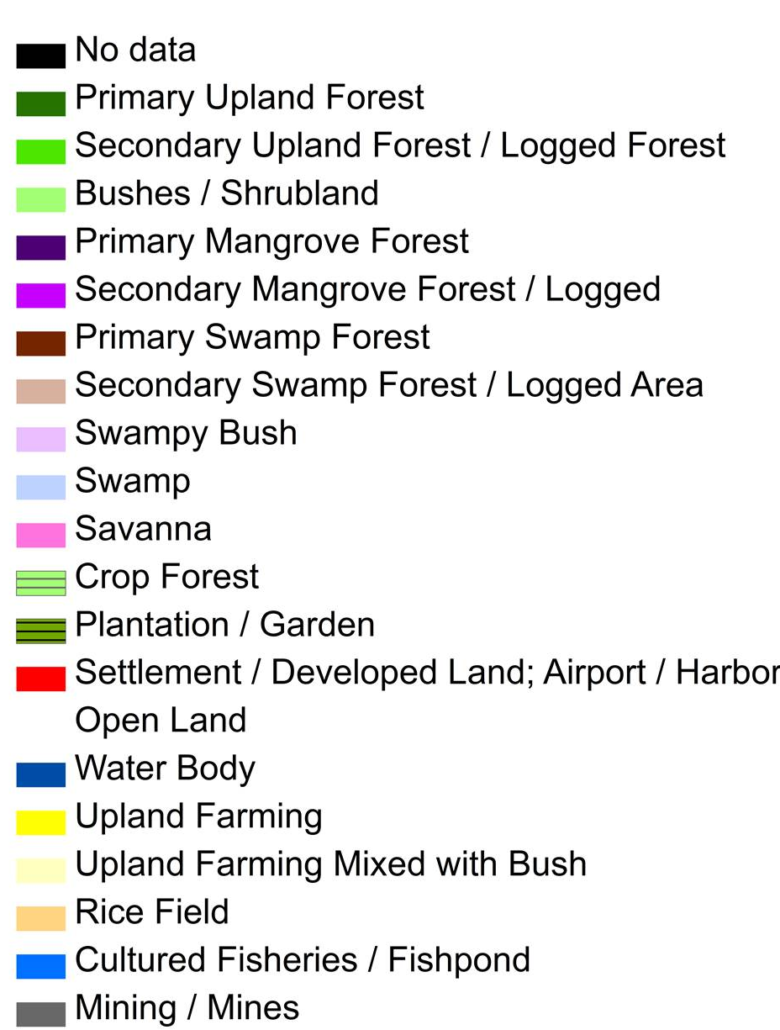
Step 1. Starting point: time series of land-cover maps
Notes:
Step 1. Starting point: land-cover maps for four points in time
Land cover maps were available from the Ministry of Forestry (MOFOR) in Indonesia for the years 2000, 2003, 2006, and 2009. They were derived through visual classification of mosaic Landsat TM/ETM+ satellite data (30m x 30m resolution).
This animation shows the land-cover changes throughout these four points in time.
Source:
The analysis shown in this example was based on a study by Romijn et al. 2013.

Slide 10
Land-cover classification
Primary forest
1 | Primary upland forest
2 | Primary mangrove forest
3 | Primary swamp forest
Degraded forest
4 | Secondary upland forest
5 | Secondary mangrove forest
6 | Secondary swamp forest
7 | Forest plantation (i.e., Eucalypt, Acacia, Teak)
8 | Bushes / shrubland
9 | Bushy swamp
Nonforest
10 | Plantation (oil palm)
11 | Savanna
12 | Upland agriculture
13 | Upland agriculture mixed with bush
14 | Rice field
15 | Cultured fisheries / fishpond
16 | Settlement / developed land
17 | Transmigration
18 | Open land
19 | Mining / mines
20 | Water body
21 | Swamp
22 | Airport
Using the FAO forest definition:
Forest > 0.5 ha
Tree canopy cover > 10%
Tree height > 5m
forest being the predominant land use in the area
Notes:
The maps consisted of 22 different land-cover classes. Here they are grouped under “primary forest,” “degraded forest,” and “nonforest.”
Before starting the analysis, a decision has to be made on the definition of forest, as this can have consequences on estimating areas of deforestation. This example employs the FAO forest definition, which defines forest as an area of > 0.5 ha, with tree canopy cover >10% and trees > 5m (or able to reach a height of > 5m), with forest being the predominant land use in the area.
The FAO forest definition was used not only to make this classification of forest types but also to map and quantify deforestation. Following the FAO definition, nine different land-cover types were classified as forest: three of which were primary forest and six of which were degraded forest types.

Slide 11
Step 2. Map deforestation areas for subsequent time periods
Forest, defined following the FAO forest definition
Deforestation, degradation, reforestation/regeneration:
degradation
Primary Forest
Degraded Forest
Forest
deforestation
reforestation/ regeneration
deforestation
Nonforest
Nonforest Classes
Notes:
The next step is to map deforestation areas for the three subsequent time periods (2000–2003, 2003–2006, and 2006–2009).
This figure shows how deforestation, forest degradation, and reforestation / regeneration were defined. Deforestation was defined as the change from primary or degraded forest into nonforest, and degradation was defined as the change from primary forest into degraded forest.

Slide 12
Deforestation and forest degradation in Indonesia between 2000 and 2009
Notes:
Deforestation areas can be mapped and calculated by comparing different land-cover maps for two points in time.
Using GIS and/or Excel software, the land cover classes from the maps of 2000–2003, 2003–2006, and 2006–2009 and the entire period 2000–2009 were compared and deforestation areas were mapped.
This figure shows deforestation and degradation areas for Indonesia for 2000–2009, based on the FAO forest definition.

Slide 13
Step 3. Link deforested areas to postforest land use
Mapping direct drivers: land cover following deforestation
Postforest land use | Land cover class
Commercial agriculture | Plantation (oil palm)
 | Upland agriculture
 | Rice field
Subsistence agriculture | Upland agriculture mixed with bush
Urban and Infrastructure | Settlement / developed land
 | Transmigration
 | Airport / harbor
Mining | Mining / mines
Aquaculture | Cultured fisheries / fish pond
Open land | Open land
Notes:
For the areas that were deforested in a certain time step (e.g., 2000–2003), the land cover that was present in the most recent land-cover map was recorded (in this case the map of 2003). This land cover gives an indication of the activity that caused the deforestation.
The different land-cover types that could follow deforestation were grouped into several distinct categories that reflect different drivers of deforestation.
This is termed “postforest land use,” which is directly linked to the drivers of deforestation.

Slide 14
Drivers of deforestation 2000–2009: Postforest land use per the FAO forest definition
Notes:
Using GIS software, the different postforest land use categories (drivers) were mapped. This map shows the postforest land-use classes for areas that were deforested between 2000 and 2009.

Slide 15
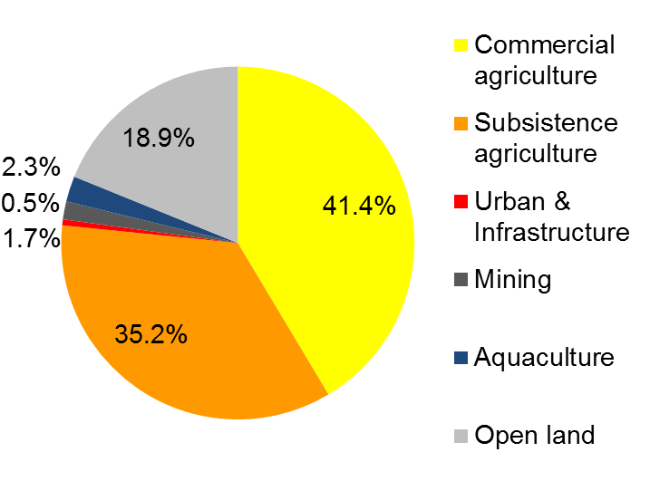
Step 4. Quantify the different drivers of deforestation (for the time period 2000–2009)
Distribution of different drivers in terms of area change
Driver | Area (km²)
Commercial agriculture | 19301.63
Subsistence agriculture | 16398.55
Urban and infrastructure | 252.18
Mining | 769.72
Aquaculture | 1090.94
Open land | 8788.51
Source: MOFOR 2011.
Notes:
Based on the drivers maps in GIS and with use of Excel software, areas for each driver were calculated. The figure and the table show the distribution of the different drivers in terms of area change, following the FAO forest definition, for the time period 2000 to 2009.

Slide 16
Step 5. Possibility of linking different drivers to GHG emissions
Reporting of carbon and other GHG emissions for each driver is encouraged
Following information required:
Carbon density (emission factor) for each different forest type, to quantify total emissions (= area of deforestation X emission factor) (See modules 2.3 and 2.5.)
Additional emissions related to specific drivers, these may occur after the deforestation and depend on the type of driver
Notes:
Countries are encouraged to report their carbon and other GHG emissions per activity that caused deforestation. This was not done in this study. It gives important information on the amount of GHG emissions and where mitigation actions should be prioritized. It is possible to calculate this, when the following numbers are known:
Carbon density for each different forest type
Additional carbon emissions related to specific drivers
Carbon density has to be multiplied by the area of deforestation per driver, for each type of forest. This gives the total amount of carbon emissions for the different drivers per forest type.
Some drivers have additional carbon emissions, caused by the land use that follows deforestation. An example of this is agriculture. Additional amounts of carbon and other GHGs are emitted depending on the type of crops or livestock, management type, use of fire, fertilizer, and soil carbon content. These GHG emissions should be considered as well.

Slide 17
Recommended modules as follow up
Module 2.1 to proceed with REDD+ measuring and monitoring and focus on monitoring activity data for forests using remote sensing
Modules 3.1 to 3.3 to learn more about REDD+ assessment and reporting

Slide 18
References
Defourny, P., C. Delhage, J-P. Kibambe Lubamba. 2011. Analyse quantitative des causes de la deforestation et de la degradation des forets en République Démocratique du Congo. Kinshasa: FAO-RDC Coordination nationale REDD N°UNJP/DRC /041/01/2009. http://www.un-redd.org/Newsletter35/DRC_Drivers_of_Deforestation/tabid/105802/Default.aspx.
Mahonghol, Denis. 2012. Analyse qualitative des causes et agents de la déforestation et de la dégradation des terres forestières dans une RDC post-conflit. Evaluation environnementale post-conflict (EEPC). Kinshasa : Division Post-Conflit et Gestion des Désastres Programme Pays de la RDC. http://www.un-redd.org/Newsletter35/DRC_Drivers_of_Deforestation/tabid/105802/Default.aspx.
MECNT (Ministère de l’Environnement, Conservation de la Nature et Tourisme). 2012a. Étude qualitative sur les causes de la déforestation et de la dégradation des forêts en République Démocratique du Congo. Kinshasa: Groupe de Travail Climat REDD. http://www.un-redd.org/Newsletter35/DRC_Drivers_of_Deforestation/tabid/105802/Default.aspx.
MECNT. 2012b. Synthèse des études sur les causes de la déforestation et de la dégradation des forêts en République Démocratique du Congo. Kinshasa. http://www.un-redd.org/Newsletter35/DRC_Drivers_of_Deforestation/tabid/105802/Default.aspx.

Slide 19
Ministry of Forestry (MOFOR), 2011. Digital Land Cover Map 2009. Ministry of Forestry, Jakarta, Indonesia (unpublished).
Romijn E., J. H. Ainembabazi, A. Wijaya, M. Herold, A. Angelsen, L. Verchot, and D. Murdiyarso. 2013. “Exploring Different Forest Definitions and Their Impact on developing REDD+ Reference Emission Levels: A Case Study for Indonesia. Environmental Science and Policy 33: 246–259.

