Slide 1
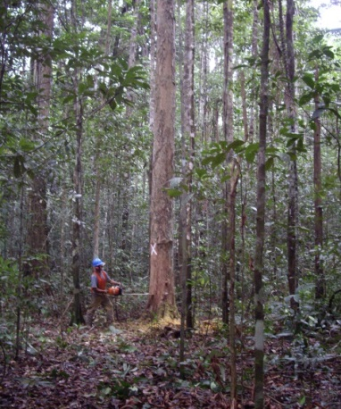
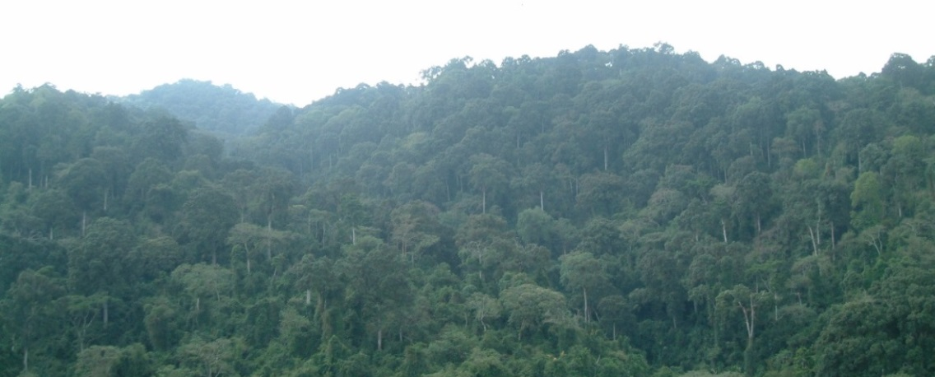
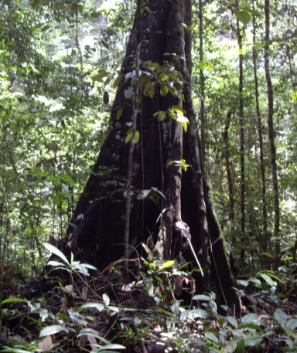
Introduction to REDD+ training materials
Coordinated by:
GOFC-GOLD LC PO & Wageningen University
In partnership with the World Bank FCPF
Version 1, May 2015

Slide 2
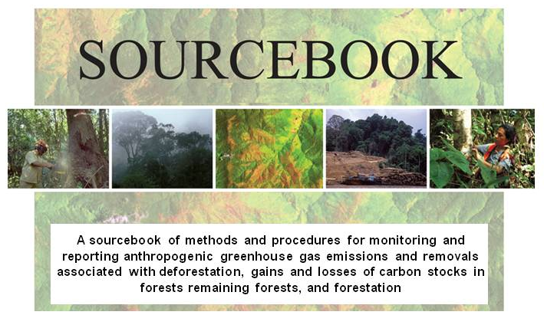
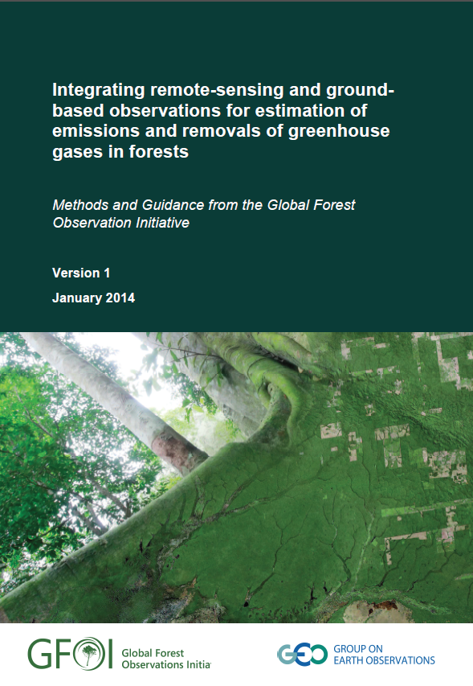
Objectives of training materials
Respond to the need for technical assistance and guidance for countries to develop capacities and implement REDD+ monitoring and reporting
Provide a set of modular training materials that can be used in combination with complementary guidance documents (i.e. IPCC GPG, GOFC-GOLD Sourcebook, GFOI MGD, WB FCPF documents, FAO/UN-REDD documents)
Based on GOFC-GOLD Sourcebook, building upon the GOFC-GOLD expert network, supported by independent review process
For developing countries and capacity development efforts
Notes:
The sourcebook is the outcome of an ad-hoc REDD+ working group of Global Observation of Forest and Land Cover Dynamics (GOFC-GOLD), a technical panel of the Global Terrestrial Observing System (GTOS) http://www.gofcgold.wur.nl/
The sourcebook provides a consensus perspective from the global community of earth observation and carbon experts on methodological issues relating to quantifying greenhouse gas (GHG) impacts of implementing mitigation activities related to the forest land use in developing countries (REDD+); it emphasizes the role of satellite remote sensing as an important tool for monitoring changes in forest cover; it provides guidance on how to obtain credible estimates of forest carbon stocks and related changes; and it provides clarification on the use of IPCC Guidelines for estimating and reporting GHG emissions and removals from forest lands
The Global Forest Observations Initiative (GFOI) was established by the Group on Earth Observations in 2011, to assist countries to produce reliable, consistent and comparable reports on change in forest cover and forest use and associated anthropogenic greenhouse gas emissions or removals.
The purpose of the Methods and Guidance Document is to provide methodological advice on the use of remotely sensed data together with ground-based observations to estimate and report greenhouse gas emissions and removals associated with forests in a manner consistent with the greenhouse gas inventory guidance from Intergovernmental Panel on Climate Change (IPCC), as required by decisions by the United Nations Framework.

Slide 3




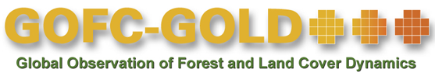



Coordination team, Developers & Reviewers
Coordination team:
World Bank FCPF
  Alexander Lotsch
GOFC-GOLD LC PO & Wageningen University
  Martin Herold - Overall project leader
  Brice Mora - Coordination and cooperation with international experts and institutions
  Erika Romijn - Coordination of the technical and organizational implementation
Development team:
Suvi Monni (Benviroc), Frédéric Achard, Giacomo Grassi, Andreas Langner, Jukka Miettinen, Yosio Shimabukuro (European Commission, Joint Research Centre), Carlos Souza (Imazon), Luigi Boschetti (University of Idaho), Arturo Balderas Torres, Margaret Skutsch (Universidad Nacional Autónoma de Mexico), Veronique De Sy, Martin Herold, Brice Mora, Erika Romijn (Wageningen University), Sandra Brown, Felipe Casarim, Lara Murray (Winrock International)
Independent reviewers:
Naikoa Aguilar-Amuchastegui, Valerio Avitabile, Veronique De Sy, Sandro Federici, Carly Green, Inge Jonckheere, Ben de Jong, Gabrielle Kissinger, Pham Manh Cuong, Ron McRoberts, Anthea Mitchel, Jim Penman, Rosa Maria Roman Cuesta, Arief Wijaya, Sylvia Wilson

Slide 4
Overview of Modules REDD+ training materials
  1.1 UNFCCC context and requirements and introduction to IPCC guidelines
  M. Herold, E. Romijn, B. Mora
  1.2 Framework for building national forest monitoring systems for REDD+
  E. Romijn, M. Herold, B. Mora
  1.3 Assessing and analyzing drivers of deforestation and forest degradation
  E. Romijn, M. Herold
REDD+ Background and Design
  2.1 Monitoring activity data for forests using remote sensing
  F. Achard, J. Miettinen, B. Mora
  2.2 Monitoring activity data for forests remaining forests (incl. forest degr.)
  C. Souza, S. Brown, J. Miettinen, F. Achard, M. Herold
  2.3 Estimating emission factors for forest cover change (def. and degr.)
  S. Brown, L. Murray, F.Casarim
  2.4 Incorporating community based approaches in national REDD+ monitoring
  M. Skutsch, A. Balderas Torres
  2.5 Estimation of carbon emissions from deforestation and forest degradation
  S. Brown, L. Murray
  2.6 Estimation of GHG emissions from biomass burning
  L. Boschetti
  2.7 Estimation of uncertainties
  G. Grassi, S. Monni, F. Achard, A. Langner, M. Herold
  2.8 Overview and status of evolving technologies
  B. Mora, E. Romijn
REDD+ Measuring and Monitoring
  3.1 National data organization and management
  E. Romijn, V. De Sy
  3.2 Data and guidance on developing REDD+ reference levels
  M. Herold, E. Romijn, S. Brown
  3.3 Guidance on reporting REDD+ performance using IPCC Guidelines and Guidance
  G.Grassi, E. Romijn, M. Herold
REDD+ Assessment and
Reporting
Notes:
The training modules follow the outline of the GOFC-GOLD REDD+ Sourcebook. A set of fourteen modules under three main components are available:
1. REDD+ background and design
2. REDD+ measuring and monitoring
3. REDD+ assessment and reporting
REDD+ Background and Design: 3 modules related to REDD+ policy and setting up national forest monitoring systems
REDD+ Measuring and Monitoring: 8 modules related to actual measurement and monitoring. It includes modules on using different remote sensing techniques to assess forest cover change (also evolving technologies); community based approaches, approaches to measure and estimate carbon stocks and emissions, to assess biomass burning and to estimate uncertainties
REDD+ Assessment and Reporting: 3 modules on organizing the data, developing reference emission levels and on reporting REDD+ performance

Slide 5

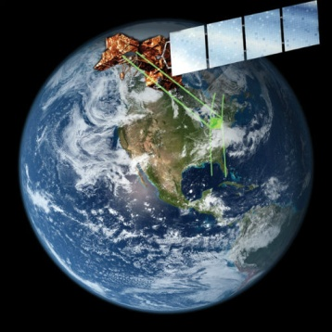
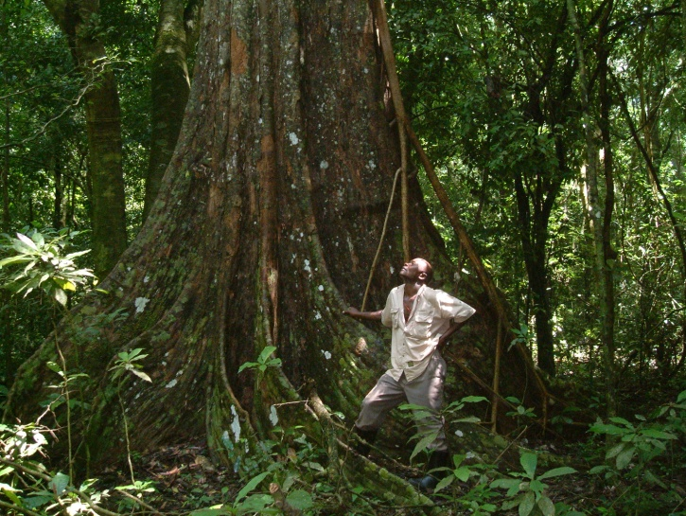
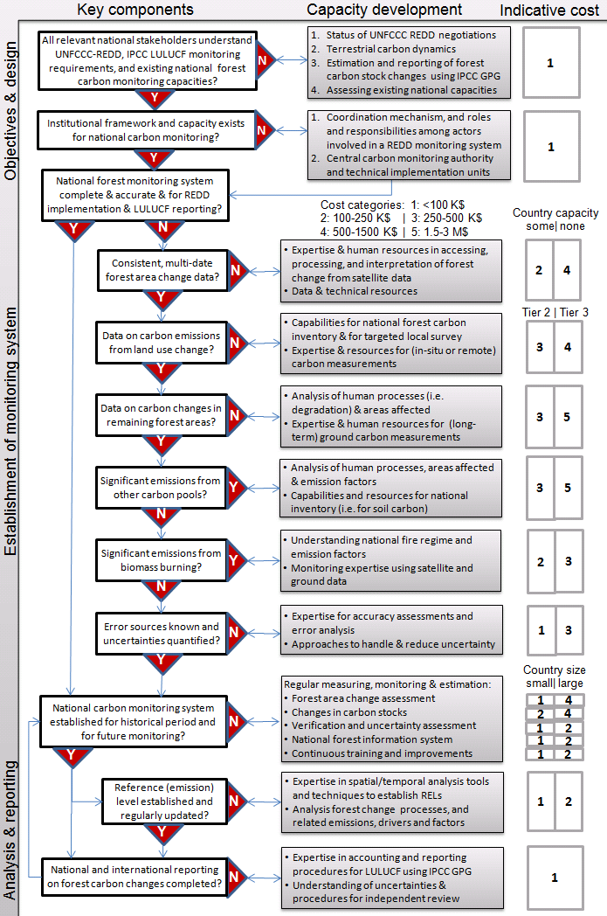
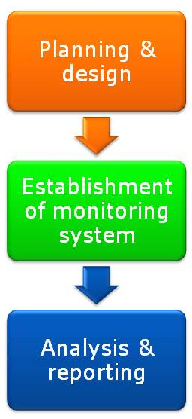
Set up of Modules & Target users
Background lectures
Background lectures
Introducing and presenting the background; relevance of topic & overview of possible methodological options and approaches
Intended for: REDD+ national and international policy makers; Project managers and Technical staff
Module 1.2 Framework for building national forest monitoring systems for REDD+
Module developers:
Erika Romijn
Martin Herold
Brice Mora
After the course the participants should be able to:
Understand the needs and priorities of a national REDD+ policy and implementation strategy
Assess and characterize forest monitoring and reporting capacities of developing countries in different national circumstances
Develop a roadmap for building sustained in-country capacities for REDD+ MRV
GOFC-GOLD training materials for REDD+ monitoring and reporting
Module 1.2 Framework for building national forest monitoring systems for REDD+
Country examples
Biomass density map (in T dry matter) for 2007 for Mexico, derived from INEGI vegetation map (2007) and INFyS 2004-2008 plot data.
Practical examples
Of successful implementation activities in developing countries; experiences presenting different national circumstances
Intended for: MRV project managers & Designers and Technical staff
Practical exercises
Process for establishing a NFMS
Practical exercises and short tutorials
To reinforce the topic and/or to provide simple hands-on exercises for implementation
Intended for: Technical staff
Notes:
Design of the training materials
To make the materials useful for different levels of knowledge and capacity needs, each module includes a lecture, concrete country examples and short tutorials or exercises to respond to the broad scope of capacity needs ranging from basic knowledge on the theoretical underpinnings to sharing practical experiences and understanding implications of monitoring choices and costs.
Intended use and audience
The training materials are intended for different actors involved in capacity development, such as international agencies, donors, country experts, consultants and researchers and can be used in combination and complementary to available guidance documents (i.e. GOFC-GOLD Sourcebook http://www.gofcgold.wur.nl/redd/, GFOI MGD http://www.gfoi.org/methods-guidance-documentation, FCMC MRV manual http://www.fcmcglobal.org/mrvmanual.html). The materials are self-explanatory and can also be used by individuals who wish to learn more about a certain tropic.
Background lectures (+/- 2 hours presentation)
Content: Introducing the background, relevance of topic; and providing an overview of possible methodological options and approaches.
Format: Self-explanatory slideshow (Powerpoint) with annotations
Target users for training: REDD+ national and international policy makers, project managers and technical staff
Country examples (+/- 0.5 hour presentation)
Content: Practical examples of successful implementation activities in developing countries, experiences presenting different national circumstances (i.e. low and high capacity countries, low and high deforestation rates, different drivers and different continents)
Format: Self-explanatory slideshow (Powerpoint) with annotations
Target users for training: MRV project manager / designers, Technical staff
Practical exercises (varies per module and intensity of training; 0.5-2 hour workshop)
Content: Practical exercises and short tutorials meant to reinforce the topic and/or to provide simple hands-on exercises for implementation, data processing and analysis
Format: Report / tutorial (MS Word), slideshows (Powerpoint), calculation spreadsheets
Target users for training: Technical staff

Slide 6
Contents of training materials
14 Modules
  Lectures: ~700 lecture slides
  28 Country examples
  28 Exercises
Background materials per module
  Folders with relevant research articles, reports and web links
Guidance document
  Background and objectives
  Relevant background (training) materials
  Module specific guidance
  List of acronyms
  Glossary

Slide 7

Distribution License of Training Materials
Allowing commercial use of the materials
Restricting distribution of adaptations
=­> Creative Commons Attribution-NoDerivatives 4.0 International License
https://creativecommons.org/licenses/by-nd/4.0/

Slide 8
Introduction to REDD+ training materials
http://www.gofcgold.wur.nl/redd/Training_materials.php
Citation of training materials:
Wageningen University, GOFC-GOLD, World Bank FCPF, 2015. REDD+ training materials. Version 1
Creative Commons License

