Slide 1
Forest Carbon Partnership Facility
Overview of the FCPF and
Engagement with Indigenous Peoples
Benoît Bosquet, Facility Management Team
Asia-Pacific Indigenous Peoples Dialogue with the FCPF
Chiang Mai, ThailandSeptember 25-27, 2012

Slide 2
FCPF and REDD+: Strategic Objectives
FCPF
1- Help countries become ready for REDD+
2- Pilot payments based on performance (equitable and at scale)
3- Pilot ways to improve livelihoods and conserve biodiversity
4- Disseminate lessons learned
Notes:
RRR

Slide 3
FCPF and the UNFCCC
Not the same thing
FCPF is a demonstration activity, the design of which started in 2006 (before COP13 in Bali)
Funded voluntarily
Aligns with the emerging policy guidance of the UNFCCC
Informs the UNFCCC negotiations through country-led implementation
FCPF has a set lifetime: due to close in 2020
FCPF and Phases of REDD+
Phases 1 and 2 (Carbon Fund = “results-based demonstration activities”)
Notes:
3

Slide 4
FCPF: Structure and Governance (1)
Participants Assembly (PA),
incl. Observers from IPs & CSOs
Technical Advisory Panels (TAPs)
Participants Committee (PC),
incl. Observers from IPs & CSOs
Secretariat (FMT)
Readiness
Fund
36 countries
Carbon
Fund
~5 countries
Grants and technical assistance
Payments for verified emission reductions
Trustee (World Bank)
Delivery Partners
Notes:
RRR

Slide 5
FCPF: Structure and Governance (2)
Countries that have requested support from
Delivery Partner other than the World Bank
IDB
Guatemala
Peru
PNUD
Cambodia
Paraguay
Guyana
Suriname
Panama
Honduras
Papua New Guinea
Central African Republic
Notes:
5

Slide 6
FCPF: Structure and Governance (3)
MDP arrangement is an FCPF-specific mechanism, different from the UN-REDD Programme
FCPF
(Multiple Delivery Partners)
FAO
UN-REDD Programme
FAO + UNDP + UNEP (delivering as one program)
UNDP
World Bank
IDB
Notes:
6

Slide 7
FCPF: Financial Contributors
Readiness Fund
$239 m
Australia
Carbon Fund
$218 m
Australia
UK
USA
Finland
Canada
Italy
Norway
Germany
United States
European Commission
BP Technology Ventures
CDC Climat
Netherlands
Japan
Spain
Switzerland
Germany
Norway
Switzerland
United Kingdom
The Nature Conservancy
Denmark
Canada
France (AFD)
Support preparation for REDD+
(2008-2020)
Pay for emission reductions
(2011-2020)
Notes:
RRR

Slide 8
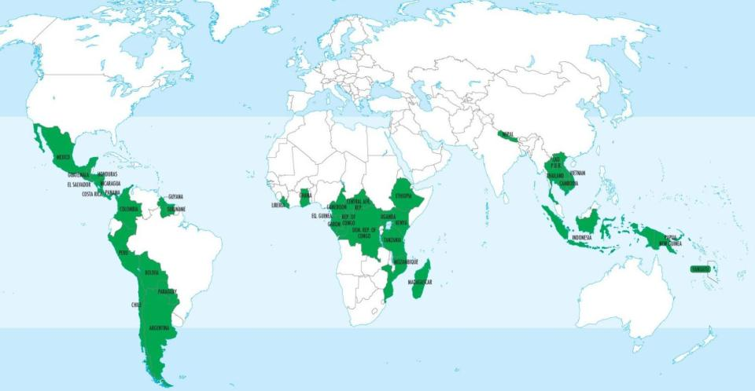
Readiness Fund: Country Participation Status (1)
37 countries selected in 2008-2009
Notes:
8

Slide 9
Readiness Fund: Country Participation Status (2)
(as of September 26, 2012)
24 countries have received assessment of their R-PPs.
Of these 24 countries, 7 have already signed a $3.8 million preparation grant.
Africa
Cent. African Rep.
Asia
Cambodia
Latin America & Caribbean
Argentina
DR Congo
Ethiopia
Ghana
Kenya
Liberia
Mozambique
Republic of Congo
Tanzania*
Uganda
Colombia
Costa Rica
Guatemala
Guyana
Mexico
Panama
Peru
Indonesia
Lao PDR
Nepal
Vietnam
Nicaragua
* No grant funding requested from FCPF
Notes:
9

Slide 10
Readiness Fund: Country Participation Status (3)
(as of September 26, 2012)
12 new countries have requested to join the Readiness Fund:
Belize, Bhutan, Burundi, Chad, Côte d’Ivoire, Jamaica, Nigeria, Pakistan, Philippines, Sri Lanka, Sudan, Togo
Another 2 countries have expressed an interest in joining:
Bangladesh, Fiji
The PC will decide whether to reopen the Readiness Fund, and on what conditions (March 2013)
There will be no financial support until then
Necessary (but not sufficient) condition for selection: R-PP draft
Notes:
10

Slide 11
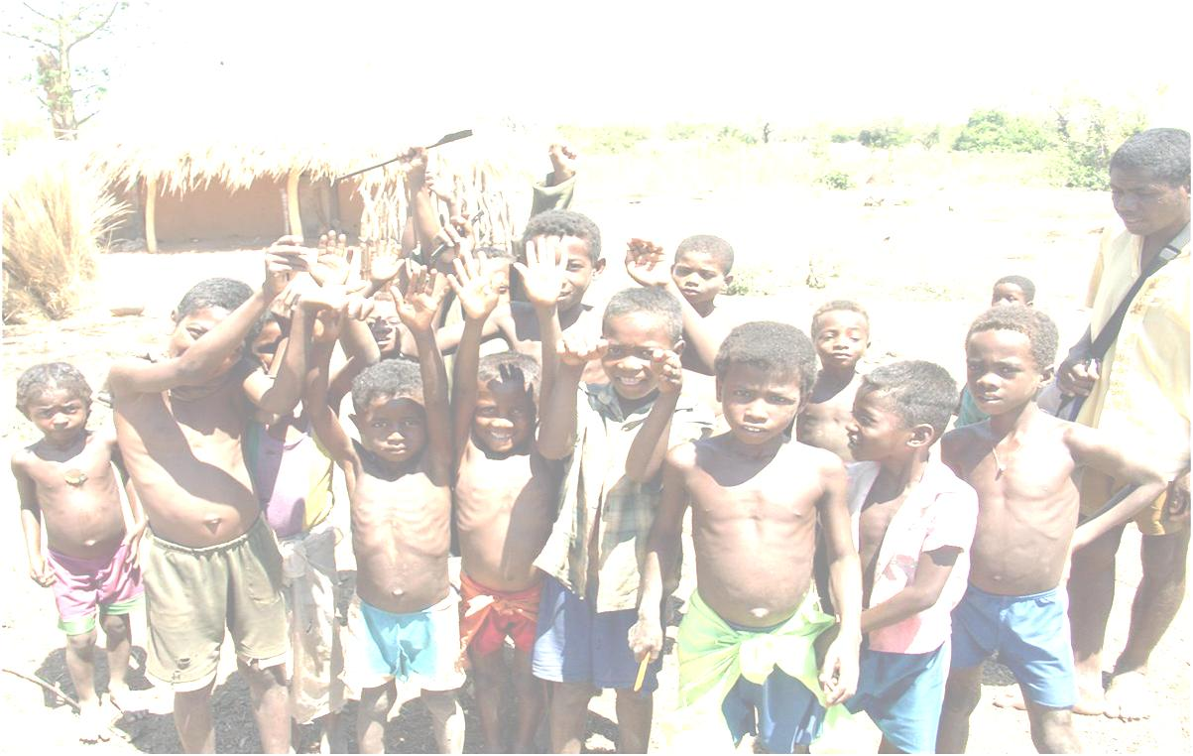
Readiness Fund (1)
Formulation and implementation of national
Readiness Preparation Proposal (R-PP)
Strategy
Reference level
Measurement, Reporting & Verification System
Institutions, incl. safeguards
Notes:
RRR

Slide 12
Readiness Fund (2)
R-PP Outline
Component 1: Organize and Consult
1a. National Readiness Management Arrangements
1b. Information Sharing and Early Dialogue with Key Stakeholder Groups
1c. Consultation and Participation Process
Component 2: Prepare the REDD+ Strategy
2a. Assessment of Land Use, Forest Law, Policy and Governance
2b. REDD+ Strategy Options
2c. REDD+ Implementation Framework
2d. Social and Environmental Impacts during Readiness Preparation and REDD+ Implementation
Component 3: Develop a Reference Level
Component 4: Design a Monitoring System
4a. Emissions and Removals
4b. Multiple Benefits, Other Impacts, and Governance

Slide 13
From Readiness to Carbon Finance
Readiness Fund
R-Package must be endorsed by the PC before an ER Program is submitted and an ERPA is signed
R-PP
Assessment
Readiness Package Endorsement
Signature of Emission Reductions Payment Agreement (ERPA)
Mid-Term Progress Report
R-PP Formulation
Readiness Preparation
Implementation
Carbon Fund
13
Notes:
The FCPF’s approach to environment and social risk management applies to each phase of REDD+
Since only a handful of countries are now fully into the Readiness Preparation phase and the Carbon Fund is just getting off the ground, this presentation focuses mainly on the elements of environment and social risk management for the Readiness Preparation phase

Slide 14
Carbon Fund: Introduction
The Carbon Fund is integral part of the FCPF’s Charter and at the heart of the FCPF
Became operational in May 2011
Methodological work is ongoing
Estimate of emission reduction potential of programs
Pricing
FCPF
Help countries become ready for REDD+
Pilot payments based on performance (equitable and at scale)
Pilot ways to improve livelihoods and conserve biodiversity
Disseminate lessons learned

Slide 15
Objectives of the Carbon Fund (1)
Mandate
Pay for Emission Reductions (ERs) from REDD+ programs and deliver them to the Carbon Fund (Tranche) Participants
Not purchase or lay claims to land or territories, only ERs
Objectives
Deliver ERs generated by ~5 REDD+ programs that
Are submitted by governments or entities with government approval
Are undertaken at a significant scale, e.g., at the level of an administrative jurisdiction within a country or at the national level
Are consistent with emerging compliance standards under the UNFCCC and other regimes
Are consistent with national REDD+ strategy and emerging MRV system and REL
Are based on transparent stakeholder consultations
Generate environmental and social co-benefits (safeguards, biodiversity)

Slide 16
Objectives of the Carbon Fund (2)
The Carbon Fund is NOT the carbon market for REDD+
Performance-based payments market
Neither World Bank nor FCPF has authority to create a carbon market for REDD+
Carbon markets for REDD+ may be created in the future by
UNFCCC
Countries
Sub-national entities
Groups of countries
Performance-based payments will be used regarding of the source of the money or the use of the emission reductions

Slide 17
Next FCPF Meetings
October 16-17, 2012 (Paris)
CF5
October 20-23, 2012 (Brazzaville, Republic of Congo)
Workshops on Readiness Package + Carbon Fund
PA5 & PC13
Back-to-back with UN-REDD PB9
March 2013 (Washington, DC)
CF6
PC14
June 2013 (Indonesia?)
Notes:
17

Slide 18
Indigenous Peoples in the FCPF:
Rationale for Engagement (1)
Forest-dependent Indigenous Peoples and local communities
Are key to the success of REDD+
Knowledge about forests
Presence on the ground for protection and monitoring
Are vulnerable if REDD+ is poorly designed and/or implemented
Rights not well defined
Enjoy special safeguards in UNFCCC and CBD decisions on REDD+
Full and effective participation
Respect of knowledge and rights
Notes:
18

Slide 19
Indigenous Peoples in the FCPF:
Rationale for Engagement (2)
FCPF Charter definition
“Forest-Dependent Indigenous Peoples and Forest Dwellers”
“Forest Dwellers” include non-Indigenous Peoples who depend on forests (e.g., local communities)
Joint “FCPF /UN-REDD Guidelines on Stakeholder Engagement in REDD+ Readiness; with a Focus on the Participation of Indigenous Peoples and Other Forest-Dependent Communities”
Notes:
19

Slide 20
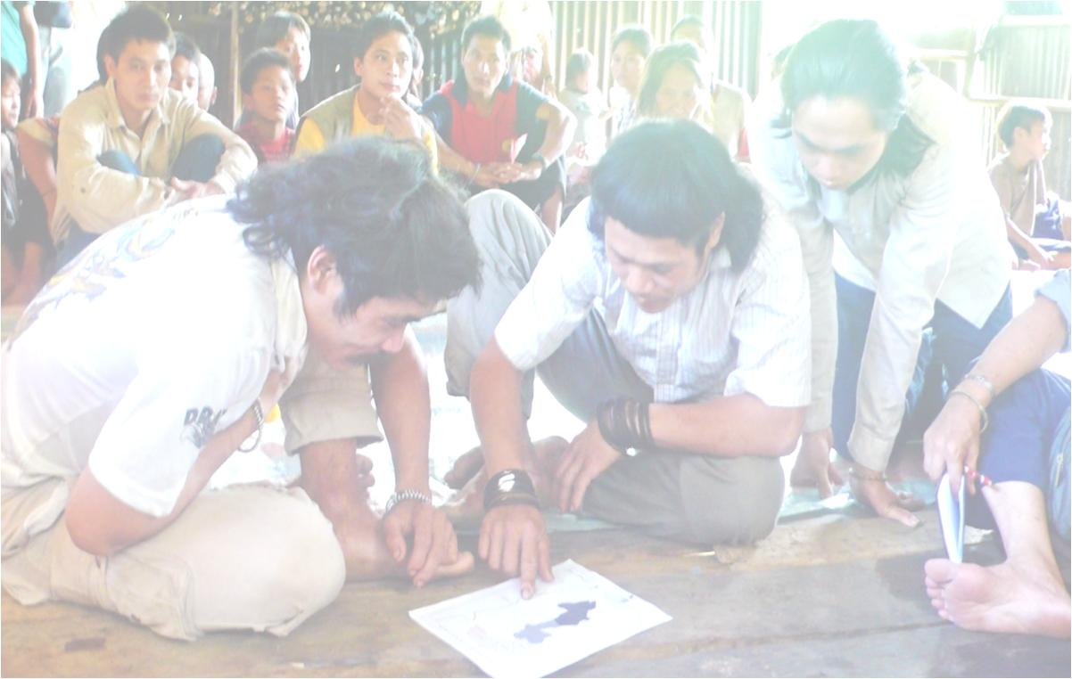
Indigenous Peoples in the FCPF:
6 Points of Engagement
Members of Technical Advisory Panels
Special Initiatives
Self-Selected Active Observers in Governance Bodies (PA, PC, Carbon Fund)
Dedicated Capacity Building Program
☑ Full and effective participation
☑ Respect of knowledge and rights
Direct Dialogues
Members of National REDD+ Institutions
Notes:
RRR

Slide 21
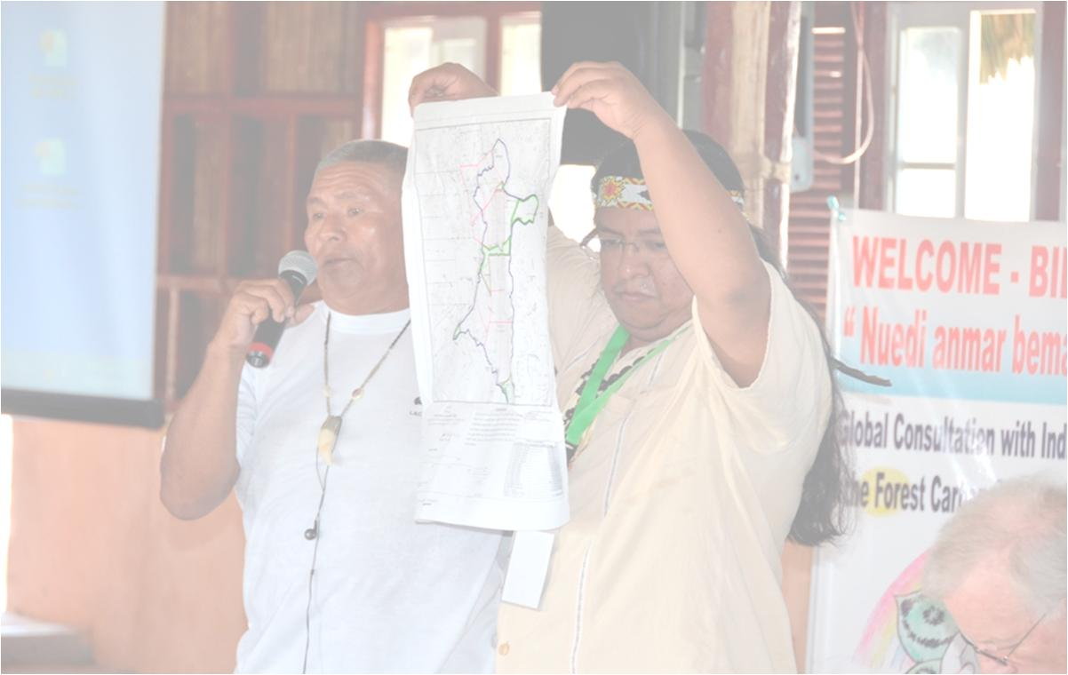
Indigenous Peoples in the FCPF:
Direct Dialogues and Beyond
3 workshops held prior to start of FCPF operations (2008)
Kathmandu, Nepal
Bujumbura, Burundi
La Paz, Bolivia
1 global dialogue
Guna Yala, Panama (September 2011)
3 regional dialogues
Arusha, Tanzania (April 2012)
Lima, Peru (August 2012)
Chiang Mai, Thailand (September 2012)
1 global dialogue
Doha, Qatar (December 2012)
Participation in numerous meetings and workshops
UNFCCC, UNPFII, COICA, UN-REDD, etc.
Notes:
21

Slide 22
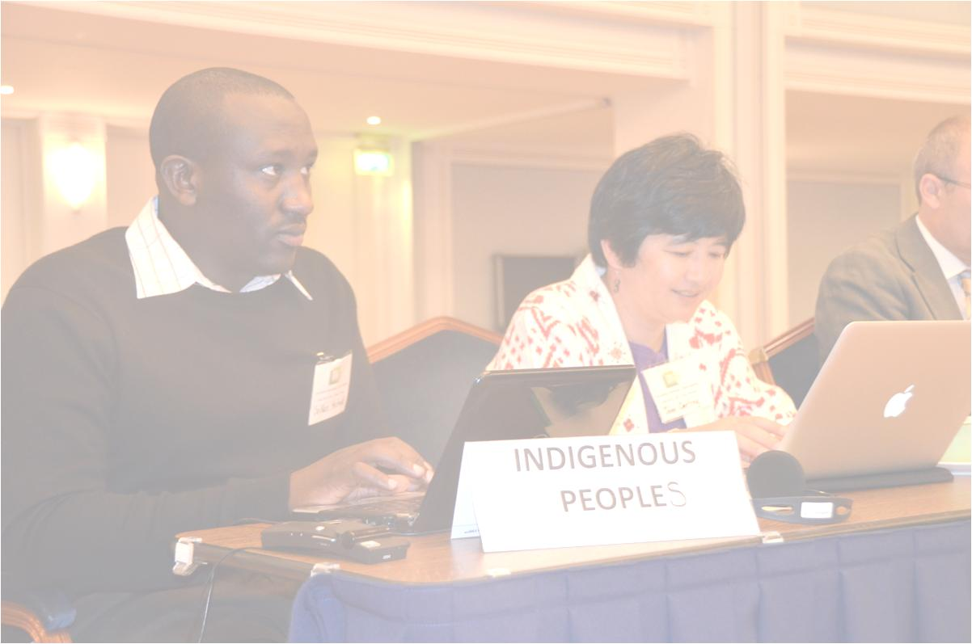
Indigenous Peoples in the FCPF:
Self-Selected Observers to Governance Structure (1)
Invited to all FCPF meetings with financial support, full access to information and full rights to participate
All Participants Assembly and Participants Committee meetings, including plenary discussions & crafting of resolutions in Contact Groups
Working Group on methodology and pricing for Carbon Fund
Task Force on Common Approach
Expectation that they will prepare for these meetings by contacting their regional networks, and disseminate information in their regions after the meetings
Notes:
22

Slide 23
Indigenous Peoples in the FCPF:
Self-Selected Observers to Governance Structure (2)
Self-selection process since mid-2011
Africa
Anglophone: Nicholas Meitiaki Soikan
Francophone: Kapupu Diwa Mutimanwa
Asia
Joan Carling (alternates Pasang Dolma Sherpa & Kittisak Rattanakrajangrsi)
Latin America & Caribbean
Meso-America: Onel Masardule
South America: Edwin Vasquez (alternate Diego Escobar)
Notes:
23

Slide 24
Indigenous Peoples in the FCPF:
Members of Technical Advisory Panels
Ad Hoc Technical Advisory Panels formed to review each national Readiness Preparation Proposal (R-PP)
International experts
National experts
1 indigenous expert or specialist in community rights
Notes:
24

Slide 25
Indigenous Peoples in the FCPF:
Special Initiatives
Community-based monitoring
International workshop in Mexico City (September 2011) on sharing experiences across countries, including civil society organizations, Indigenous Peoples and governments
Paper prepared by Tebtebba before workshop analyzing environmental and social standards for REDD+
Follow-up regional workshops (to be announced)
Notes:
25

Slide 26
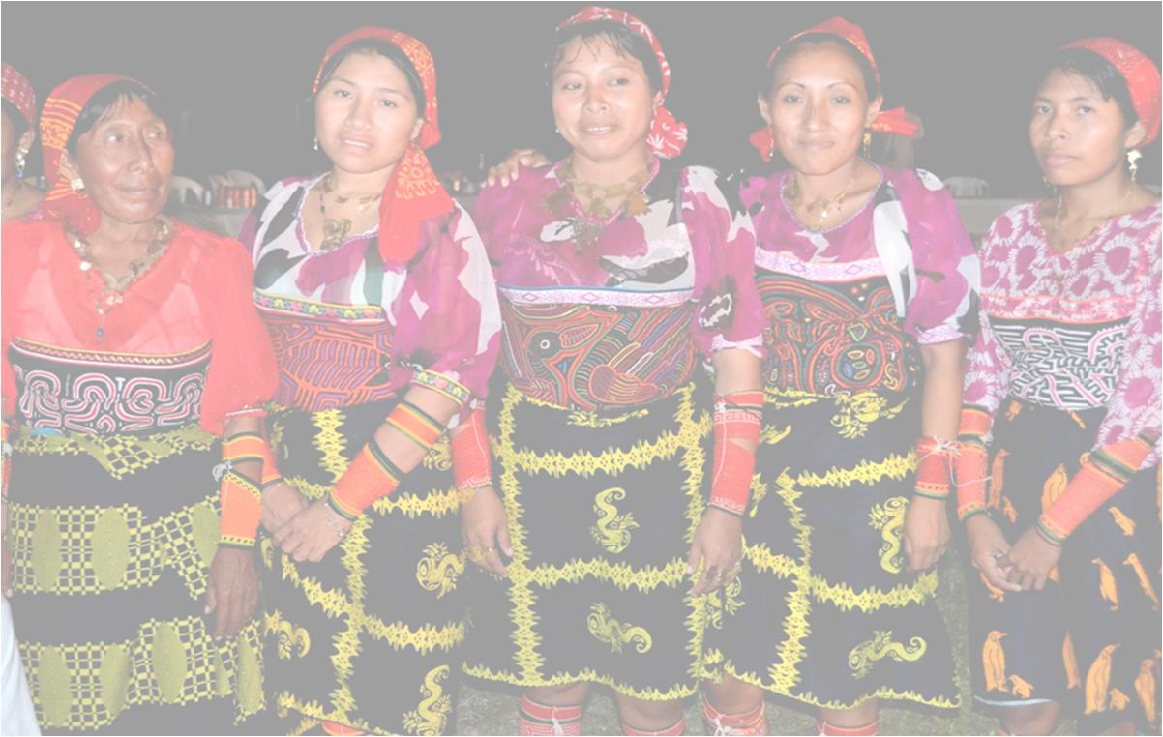
Indigenous Peoples in the FCPF:
Dedicated Capacity Building Program (1)
$200,000 per year since 2009
Expansion of existing program to ~$3.5 million (FY12-15)
Activities: ~$2.2 million
Travel & operational budget: ~$360,000
3 regional + 1 global dialogues (in addition to Guna Yala): $940,000
Subject to reorganization:
Switch to small grant system
Use of regional Indigenous Peoples’ organizations
Alignment with FIP Dedicated Grant Mechanism global component
Notes:
26

Slide 27
Indigenous Peoples in the FCPF:
Dedicated Capacity Building Program (2)
Examples
Cambodia: CDA “Community-Based REDD Consultation”
Indonesia: Telapak “Documenting the Indigenous Peoples’ Existence and Problems in Managing the Customary Forest Territory as a Form in Preparing for Climate Change Adaptation and Mitigation Process”
Nepal: NEFIN “Capacity Building of Indigenous Peoples for REDD Implementation”
Notes:
27

Slide 28
Indigenous Peoples in the FCPF:
Members of National REDD+ Institutions
REDD+ won’t succeed unless the national management arrangements are inclusive of Indigenous Peoples and local communities
FCPF country visits have facilitated dialogue and design of national REDD+ committees that includes Indigenous Peoples and local communities
Social development specialists from Delivery Partners & Facility Management Team
Guidelines in R-PP template
Joint “FCPF/UN-REDD Guidelines on Stakeholder Engagement in REDD+ Readiness; with a Focus on the Participation of Indigenous Peoples and Other Forest-Dependent Communities”
Notes:
28

Slide 29
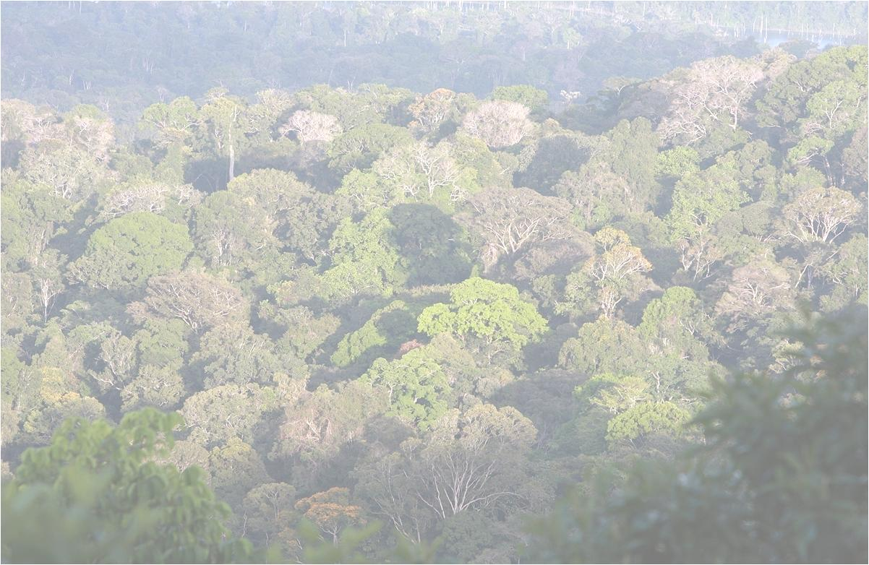
Thank you
www.forestcarbonpartnership.org
Photo credits: Rhett Butler
Notes:
RRR

