Slide 1
Cancun Agreement (COP 16) and Durban Outcome (COP 17) on REDD+
Suchitra Changtragoon
Expert on Forest Conservation Research
Expert Office, Forest and Plant Conservation Research Office
Department of National Parks, wildlife and Plant Conservation

Slide 2
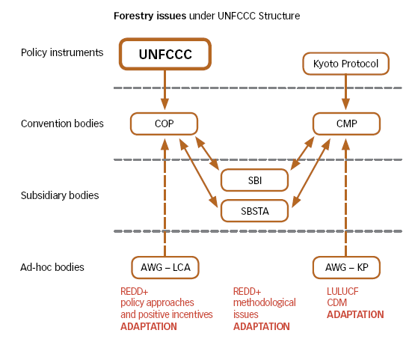

Slide 3
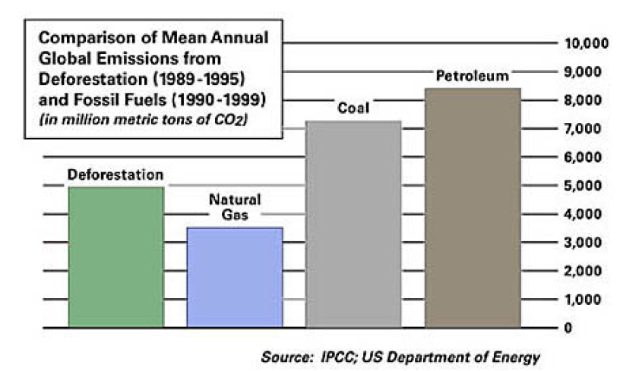
20 % Of Emission
around
the world
From: Union of Concerned Scientists. Recognizing Forest’s Role in Climate Change.
http://www.ucsusa.org/global_warming/solutions/recognizing-forests-role-in-climate-change.htm

Slide 4
When REDD⁺ has been negotiated and agreed?
Firstly proposed in COP11 (2005) by PNG and Costa Rica
REDD+ (1biii) is part of Bali Action Plan : COP13 (2007)
COP15 (2009) : commitment of developed countries on fast start financial support for REDD+ (2010-2012)
COP16 (2010) : REDD+ with support: to develop REDD+ national strategies, national REL/RL, robust national forest monitoring system for monitoring and report,ing a system how safeguards are being addressed and respected
COP17 (2011) : summary of safeguard info, REL/RL ,and options of financial sources for full implementation of results based REDD+ action

Slide 5
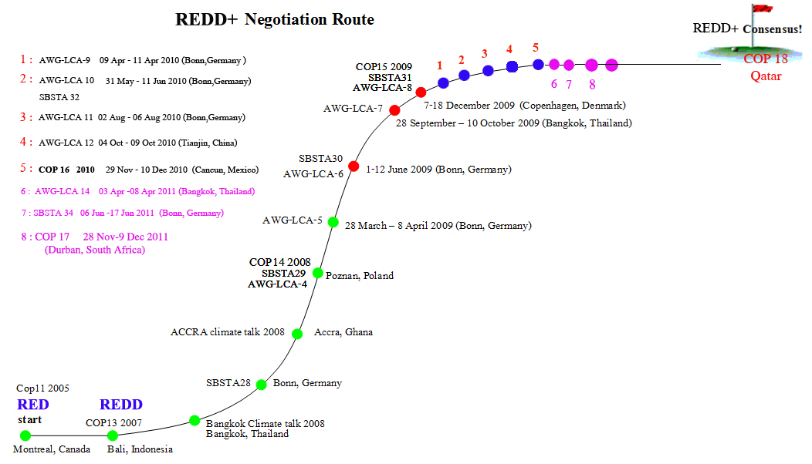

Slide 6
REDD+
AWG-LCA agenda item 3 (1b) (iii)
COP 13 (Bali)
1/CP.13, para. 1 (b) (iii)
Enhanced national/international action on mitigation of climate change, including, inter alia, consideration of:
(iii) Policy approaches and positive incentives on issues relating to reducing emissions from deforestation and forest degradation in developing countries; and the role of conservation, sustainable management of forests and enhancement of forest carbon stocks in developing countries;

Slide 7
COP 16 (Cancun)
The COP, by decision 1/CP.16,
Requested the AWG-LCA to explore financing options for the full implementation of results-based actions and to report on progress made, including any recommendations for draft decisions on this
matter, to COP17.
Requested the SBSTA to develop a work programme to:
Identify drivers of deforestation and forest degradation;
Develop modalities for forest reference (emission) levels;
Develop modalities for a national forest monitoring system;
Develop guidance for a system for providing information on how
safeguards have been addressed and respected;
Develop modalities for MRV of anthropogenic forest-related emissions.

Slide 8
68. Encourages all Parties to find effective ways to reduce the human pressure on forests that results in greenhouse gas emissions, including actions to address drivers of deforestation;
69. Affirms that the implementation of the activities referred to in paragraph 70 below should be carried out in accordance with appendix I to this decision, and that the safeguards referred to in paragraph 2 of appendix I to this decision should be promoted and supported;
70. Encourages developing country Parties to contribute to mitigation actions in the forest sector by undertaking the following activities, as deemed appropriate by each Party and in accordance with their respective capabilities and national circumstances:
(a) Reducing emissions from deforestation;
(b) Reducing emissions from forest degradation;
(c) Conservation of forest carbon stocks;
(d) Sustainable management of forests;
(e) Enhancement of forest carbon stocks;

Slide 9
71. Requests developing country Parties aiming to undertake the activities referred to in paragraph 70 above, in the context of the provision of adequate and predictable support, including financial resources and technical and technological support to developing country Parties, in accordance with national circumstances and respective capabilities, to develop the following elements:
(a) A national strategy or action plan;
(b) A national forest reference emission level and/or forest reference level⁶ or, if appropriate, as an interim measure, subnational forest reference emission levels and/or forest reference levels, in accordance with national circumstances, and with provisions contained in decision 4/CP.15, and with any further elaboration of those provisions adopted by the Conference of the Parties;
⁶ In accordance with national circumstances, national forest reference emission levels and/or forest reference levels could be a combination of subnational forest reference emissions levels and/or forest reference levels.

Slide 10
(c) A robust and transparent national forest monitoring system for the monitoring and reporting of the activities referred to in paragraph 70 above, with, if appropriate, subnational monitoring and reporting as an interim measure,⁷ in accordance with national
circumstances, and with the provisions contained in decision 4/CP.15, and with any further elaboration of those provisions agreed by the Conference of the Parties;
(d) A system for providing information on how the safeguards referred to in appendix I to this decision are being addressed and respected throughout the implementation of the activities referred to in paragraph 70 above, while respecting sovereignty;
⁷ Including monitoring and reporting of emissions displacement at the national level, if appropriate, and reporting on how displacement of emissions is being addressed, and on the means to integrate subnational monitoring systems into a national monitoring system.

Slide 11
72. Also requests developing country Parties, when developing and implementing their national strategies or action plans, to address, inter alia, the drivers of deforestation and forest degradation, land tenure issues, forest governance issues, gender considerations and
the safeguards identified in paragraph 2 of appendix I to this decision, ensuring the full and effective participation of relevant stakeholders, inter alia indigenous peoples and local communities;
73. Decides that the activities undertaken by Parties referred to in paragraph 70 above should be implemented in phases, beginning with the development of national strategies or action plans, policies and measures, and capacity-building, followed by the implementation of national policies and measures and national strategies or action plans that could involve further capacity-building, technology development and transfer and results-based demonstration activities, and evolving into results-based actions that should be fully measured, reported and verified;

Slide 12
74. Recognizes that the implementation of the activities referred to in paragraph 70 above, including the choice of a starting phase as referred to in paragraph 73 above, depends on the specific national circumstances, capacities and capabilities of each developing country Party and the level of support received;
75. Requests the Subsidiary Body for Scientific and Technological Advice to develop a work programme on the matters referred to in appendix II to this decision;
76. Urges Parties, in particular developed country Parties, to support, through multilateral and bilateral channels, the development of national strategies or action plans, policies and measures and capacity-building, followed by the implementation of national
policies and measures and national strategies or action plans that could involve further capacity-building, technology development and transfer and results-based demonstration activities, including consideration of the safeguards referred to in paragraph 2 of appendix I to this decision, taking into account the relevant provisions on finance including those relating to reporting on support;

Slide 13
Appendix I
Guidance and safeguards for policy approaches and positive incentives on issues relating to reducing emissions from deforestation and forest degradation in developing countries; and the role of conservation, sustainable management of forests and enhancement of forest carbon stocks in developing countries
1. The activities referred to in paragraph 70 of this decision should:
(a) Contribute to the achievement of the objective set out in Article 2 of the Convention;
(b) Contribute to the fullfilment of the commitments set out in Article 4, paragraph 3, of the Convention;
(c) Be country-driven and be considered options available to Parties;

Slide 14
(d) Be consistent with the objective of environmental integrity and take into account the multiple functions of forests and other ecosystems;
(e) Be undertaken in accordance with national development priorities, objectives and circumstances and capabilities and should respect sovereignty;
(f) Be consistent with Parties’ national sustainable development needs and goals;
(g) Be implemented in the context of sustainable development and reducing poverty, while responding to climate change;
(h) Be consistent with the adaptation needs of the country;
(i) Be supported by adequate and predictable financial and technology support, including support for capacity-building;
(j) Be results-based;
(k) Promote sustainable management of forests;

Slide 15
2. When undertaking the activities referred to in paragraph 70 of this decision, the following safeguards should be promoted and supported:
(a) That actions complement or are consistent with the objectives of national forest programmes and relevant international conventions and agreements;
(b) Transparent and effective national forest governance structures, taking into account national legislation and sovereignty;
(c) Respect for the knowledge and rights of indigenous peoples and members of local communities, by taking into account relevant international obligations, national circumstances and laws, and noting that the United Nations General Assembly has adopted the United Nations Declaration on the Rights of Indigenous Peoples;
(d) The full and effective participation of relevant stakeholders, in particular indigenous peoples and local communities, in the actions referred to in paragraphs 70 and 72 of this decision;

Slide 16
(e) That actions are consistent with the conservation of natural forests and biological diversity, ensuring that the actions referred to in paragraph 70 of this decision are not used for the conversion of natural forests, but are instead used to incentivize the protection and conservation of natural forests and their ecosystem services, and to enhance other social and environmental benefits;¹
(f) Actions to address the risks of reversals;
(g) Actions to reduce displacement of emissions.
¹ Taking into account the need for sustainable livelihoods of indigenous peoples and local communities
and their interdependence on forests in most countries, reflected in the United Nations Declaration on
the Rights of Indigenous Peoples, as well as the International Mother Earth Day.

Slide 17
COP 17 (Durban)
The COP, by decision 2CP.17 and 12/CP.17
Agreed that results-based finance provided to developing country Parties that is new, additional and predictable may come from a wide variety of sources, public and private, bilateral and multilateral, including alternative sources;
Considered that appropriate market-based approaches could be developed by the COP to support the results-based actions
referred to in decision 1/CP.16, paragraph 73;
Noted that non-market-based approaches could be developed;
Encouraged the operating entities of the financial mechanism under the Convention to provide results-based finance for the actions referred to in decision 1/CP.16, paragraph 73;
Invited Parties and observer organizations to submit their views on modalities and procedures for financing the results-based actions referred to in decision 1/CP.16, paragraph 73.

Slide 18
Decided that forest reference (emission) levels shall be established taking into account decision 4/CP.15, paragraph 7, and maintaining consistency with anthropogenic forest related greenhouse gas emissions by sources and removals by sinks as contained in each country’s greenhouse gas inventories;
Decided that the summary of information on how all the safeguards have been addressed and respected should be provided periodically and be included in national communications, consistent with relevant decisions of the COP on guidelines on national communications from Parties not included in Annex I to the Convention, or communication
channels agreed by the COP.

Slide 19
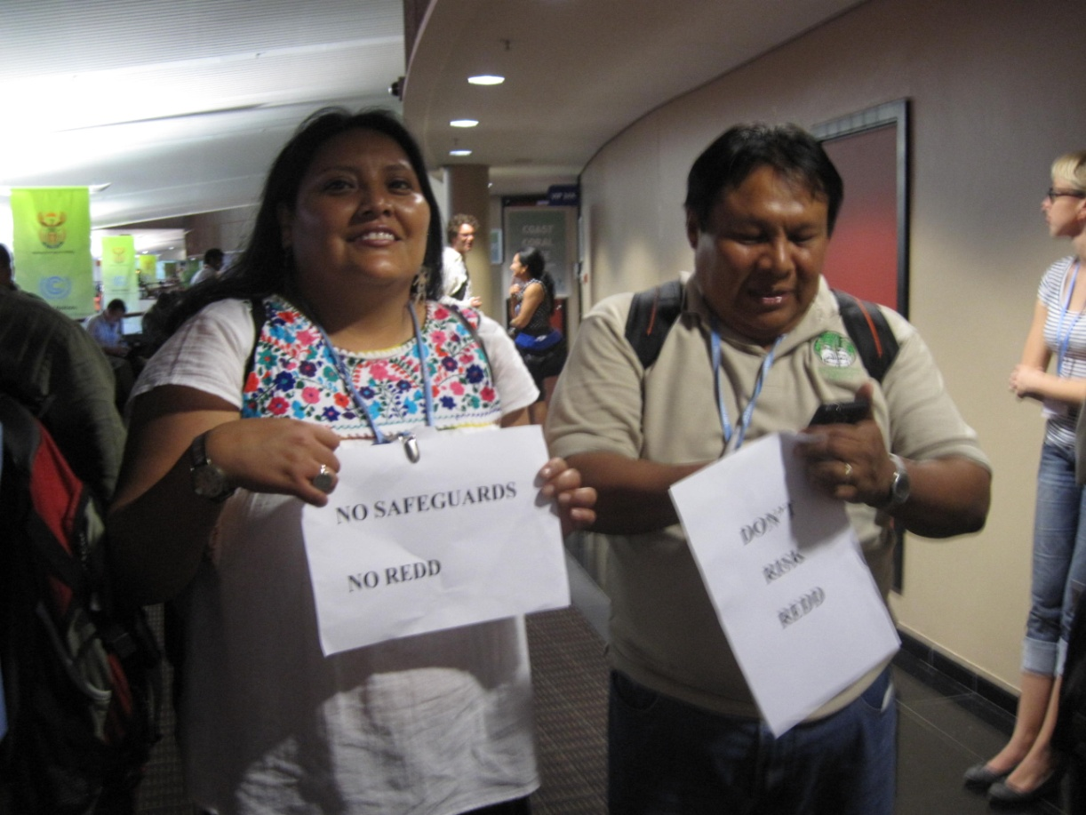

Slide 20
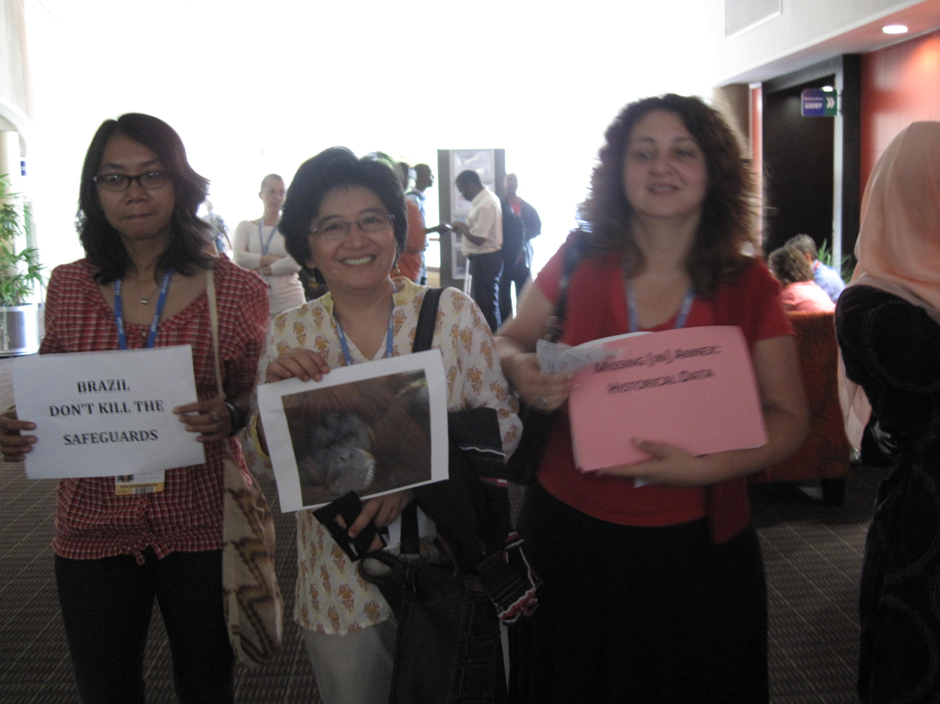

Slide 21
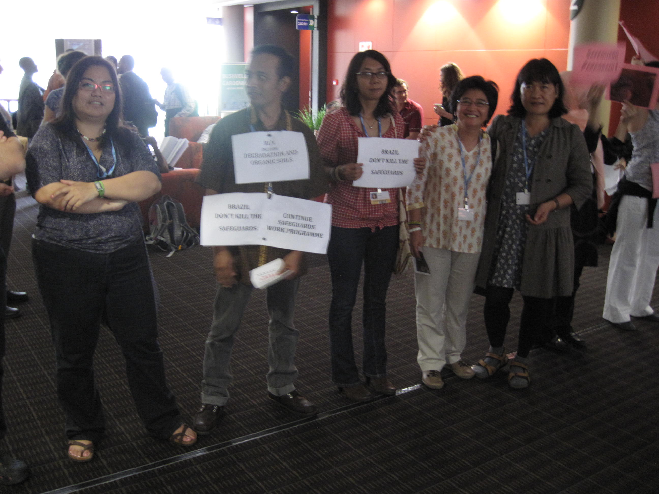

Slide 22
Summary on REDD+ safeguard
COP16 (decision 1/CP.16): 2010 | COP17 (decision 12/CP.17): 2011
Develop a system for providing information on how safeguards have been addressed and respected; | Decided that the summary of information on how all the safeguards have been addressed and respected should be provided periodically and be included in national communications, consistent with relevant decisions of the COP on guidelines on national communications from Parties not included in Annex I to the Convention, or communication channels agreed by the COP.
SB 36/LCA 15(I): 2012 | Further action
Agreed to continue consideration of guidance for a system for providing information on how safeguards have been addressed and respected at SBSTA37; | Request ed SBSTA to consider the timing and frequency of presentations of summary of information on how safeguards are being addressed and respected and consider the need for further guidance to ensure transparency, consistency, comprehensiveness and effectiveness at SBSTA37, with a view to conclude at SBSTA39;

Slide 23
ขอบคุณค่ะ

Slide 24
Thank you

